Slide 1
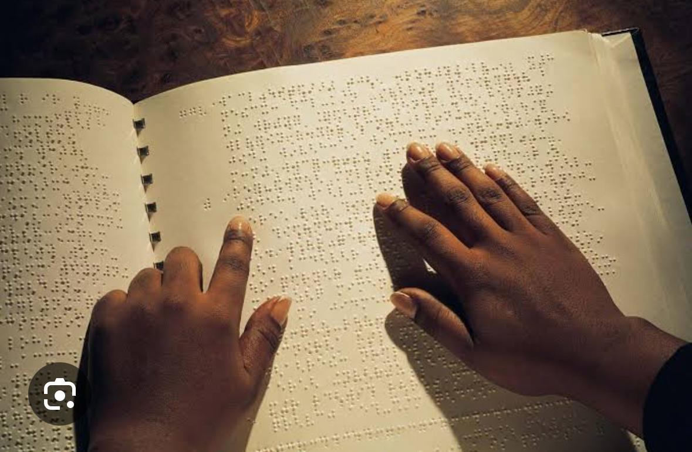
Week 9
Inclusive Education

Slide 2
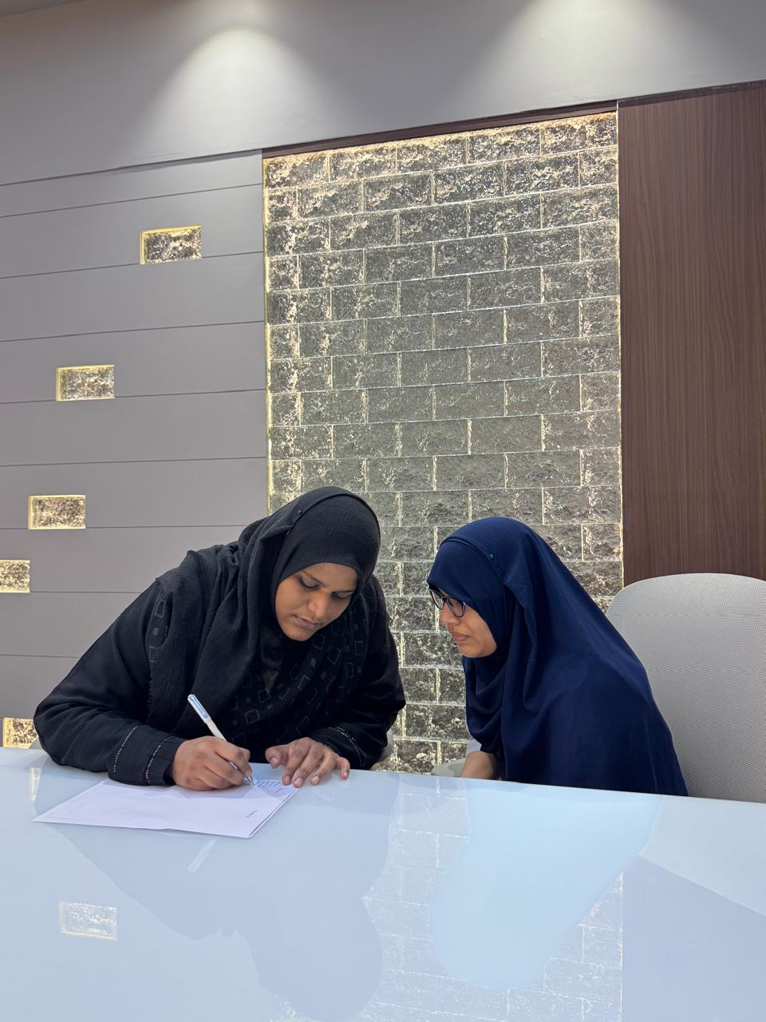

Slide 4
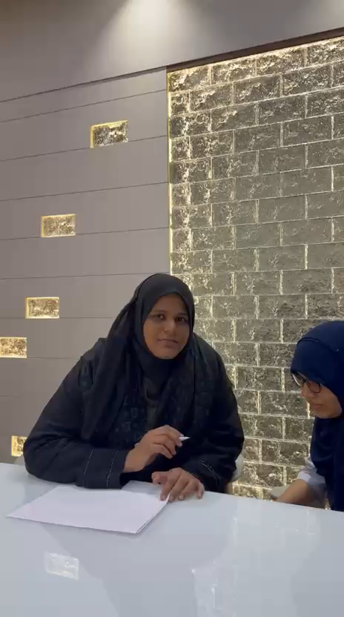

Slide 5
For SDG 4: Inclusive Education project at
M.I. Hajwani School, here are practical practices we can include:
1. Classroom & Teaching Practices
- Differentiated Instruction: Give different ways to learn the same topic. E.g: videos, diagrams, hands-on experiments, and reading for Science.
- Universal Design for Learning (UDL): Plan lessons with multiple means of engagement, representation, and expression.
- Flexible Grouping: Mix students of different abilities for projects, labs, and peer teaching. Rotate groups so no one is always "helper" or "helped".
- Multiple Assessment Options: Allow students to show understanding via quiz, poster, model, presentation, or oral explanation.
2. Peer Support & Collaboration
- Buddy System: Pair students to help each other in classwork and practicals.
- Peer Tutoring: Stronger students mentor others in specific topics, and vice-versa for different subjects.
- Circle Time / Sharing Sessions: 10 min weekly to discuss challenges and celebrate efforts.
3. Accessibility & Environment
- Accessible Materials: Big font handouts, audio explanations, sign language/visual aids for hearing impaired.
- Physical Accessibility: Check ramps, lab tables height, seating arrangement for students with mobility needs.
4. Teacher & Student Support
- Teacher Training Workshops: On handling diverse learners, using assistive tech, and positive behavior support.
- Student Sensitization: Awareness sessions on empathy, disability etiquette, and inclusion.
5. Documentation for Project
1. Photos of group work, accessible classroom setup
2. Lesson plans showing differentiation

Slide 6
THANK YOU

